Slide 1


USWDS Monthly Call
December 2022

Slide 2

Hi!
Thanks for being here!

Slide 3
Year in Review 2022
Transparent workflows
Telling the story of the code
Adapting to user settings
USWDS Compile tips
Learning what’s important

Slide 4
Year in Review 2022 What we did
(and what you might have missed)

Slide 5
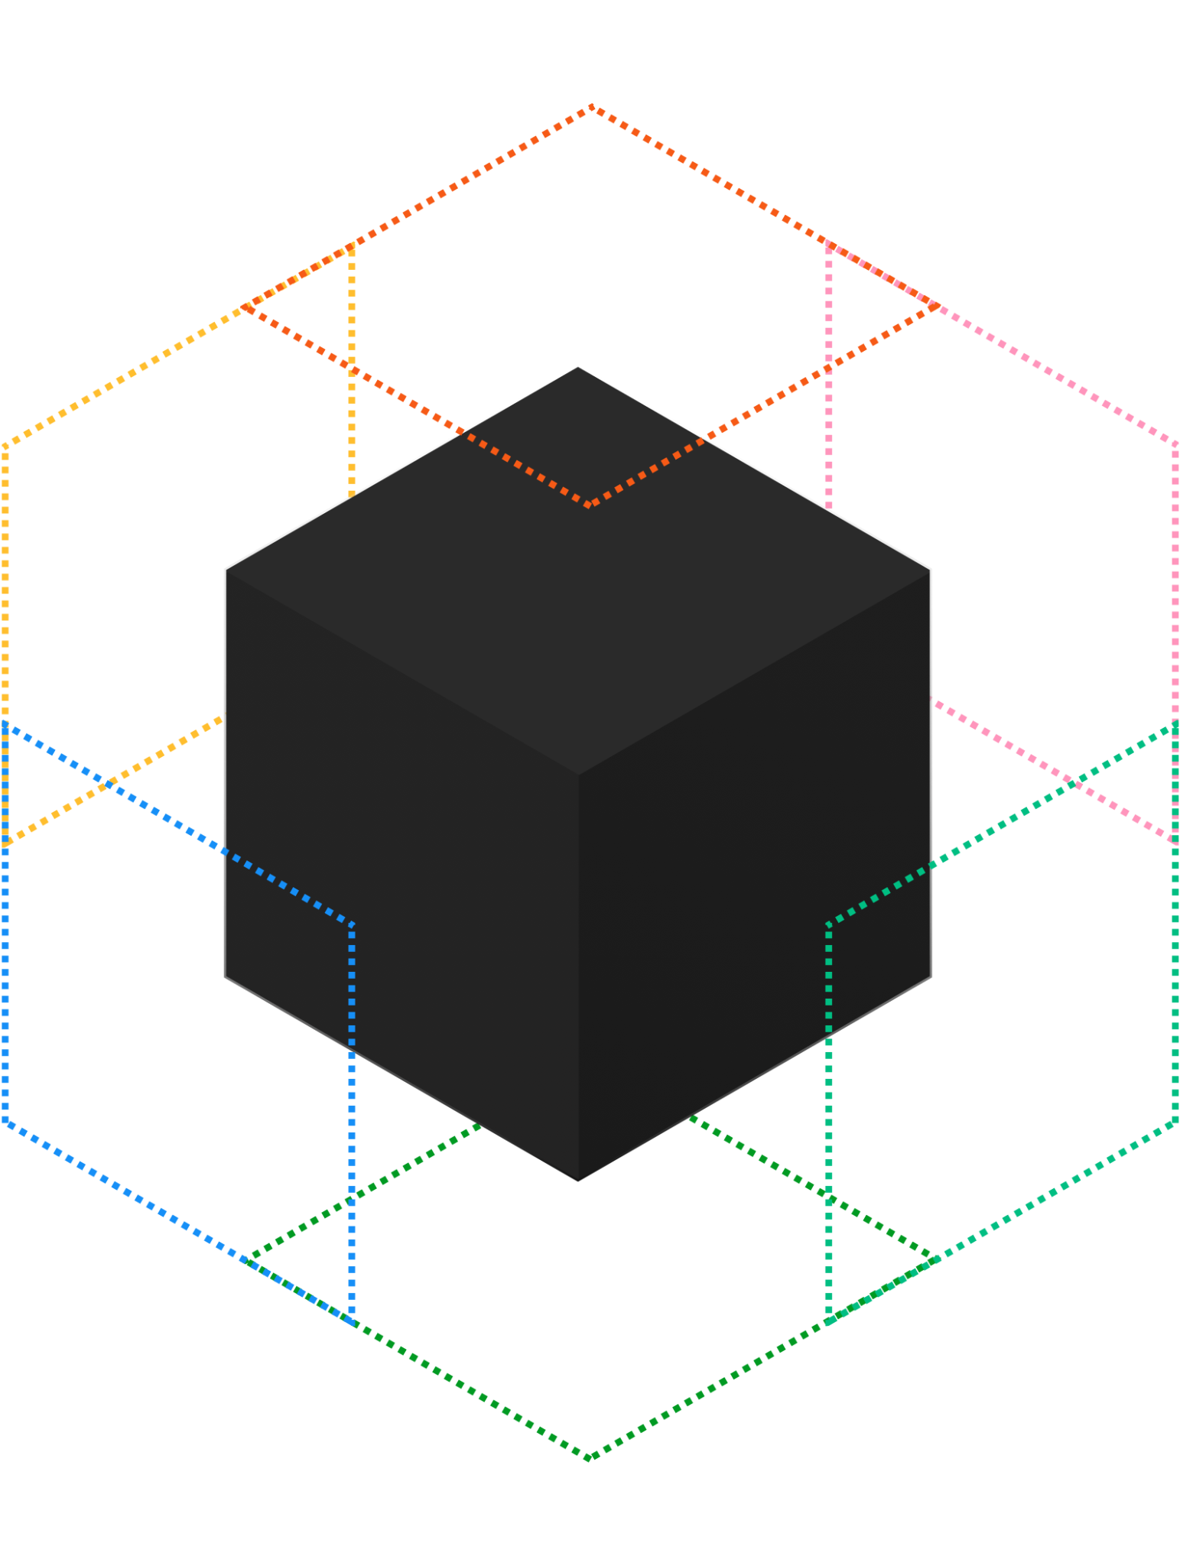
January 2022
USWDS Compile Beta

Slide 6
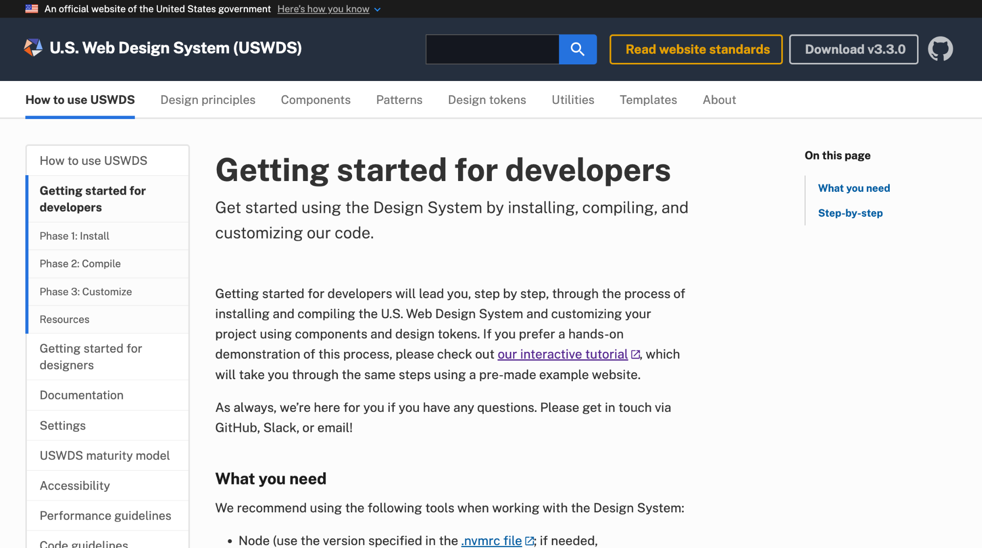
February 2022
Getting started for developers

Slide 7
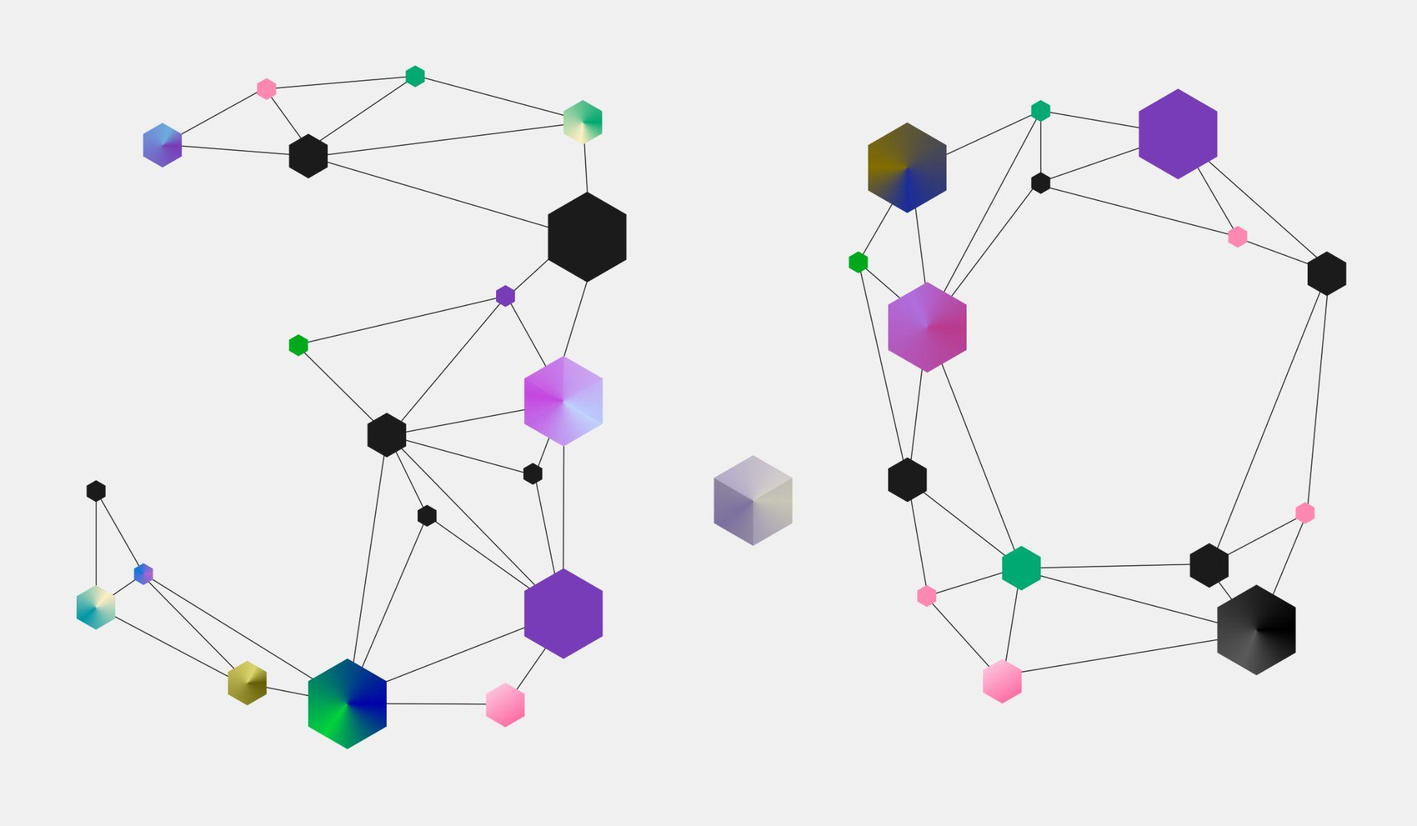
April 2022
USWDS 3.0

Slide 8
Modular package structure

Slide 9

Not a monolithic codebase…
…but a collection of modular packages. (73 KB compressed)

Slide 10
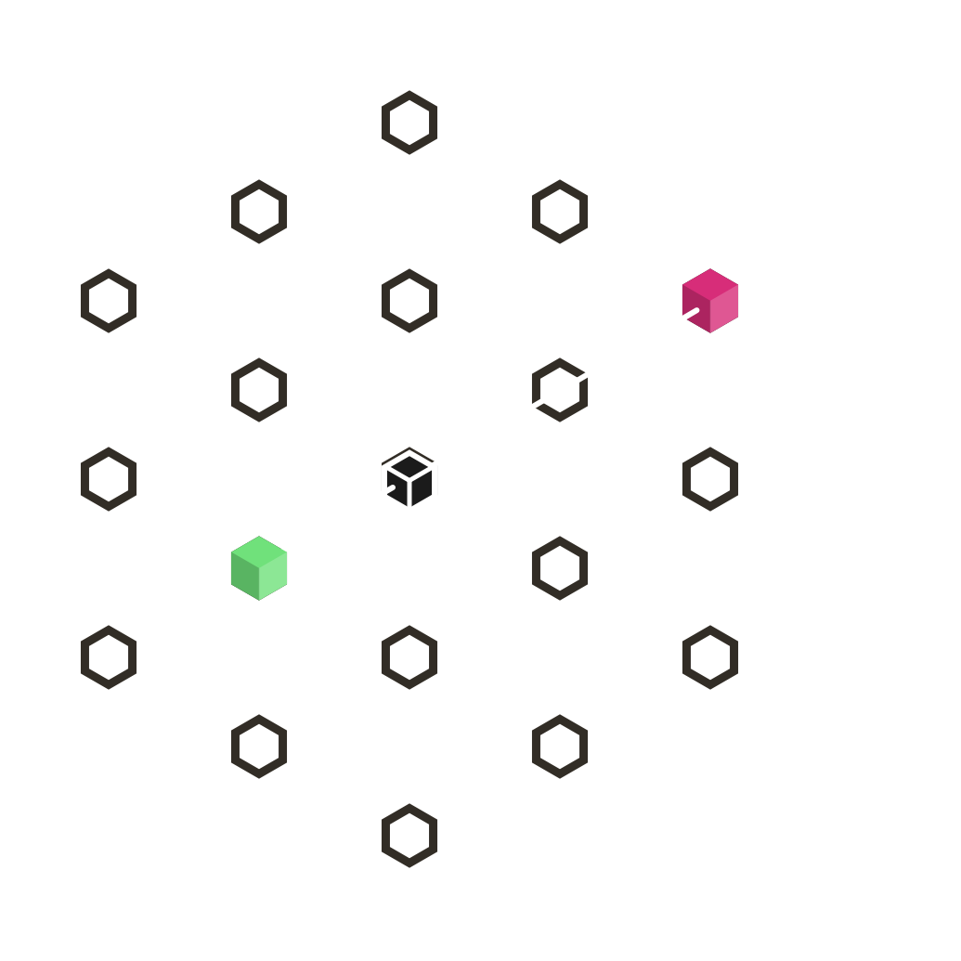
Small footprint
Just the banner and the footer
(8 KB compressed)

Slide 11
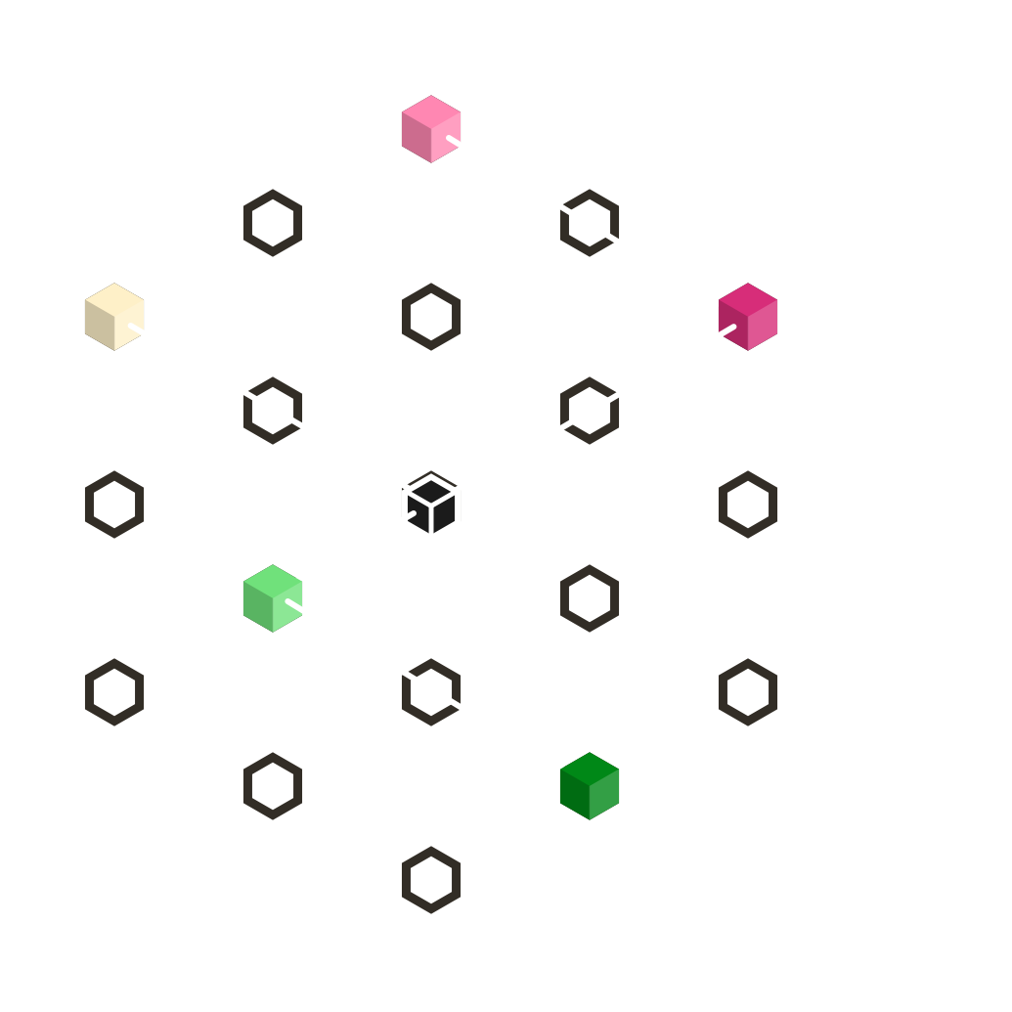
Medium footprint
Only a few components
(12 KB compressed)

Slide 12
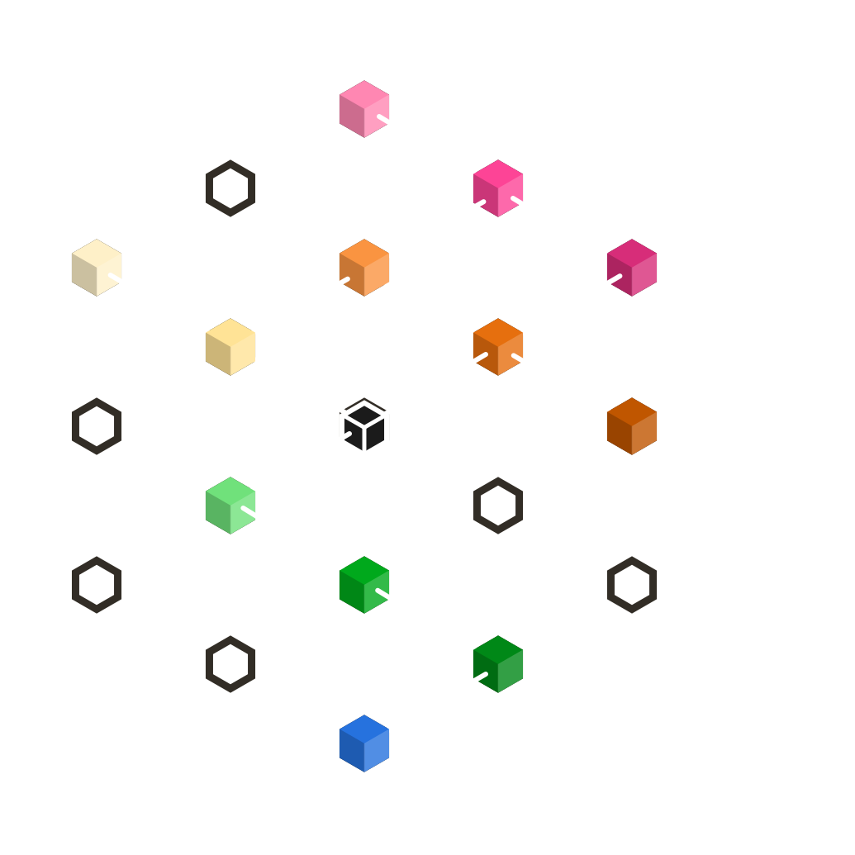
Large footprint
Even big projects probably won’t use every component.

Slide 13
USWDS 3.0
Modular package structure
Ending support for IE11
Updating to modern Sass syntax
Allowing required JavaScript

Slide 14
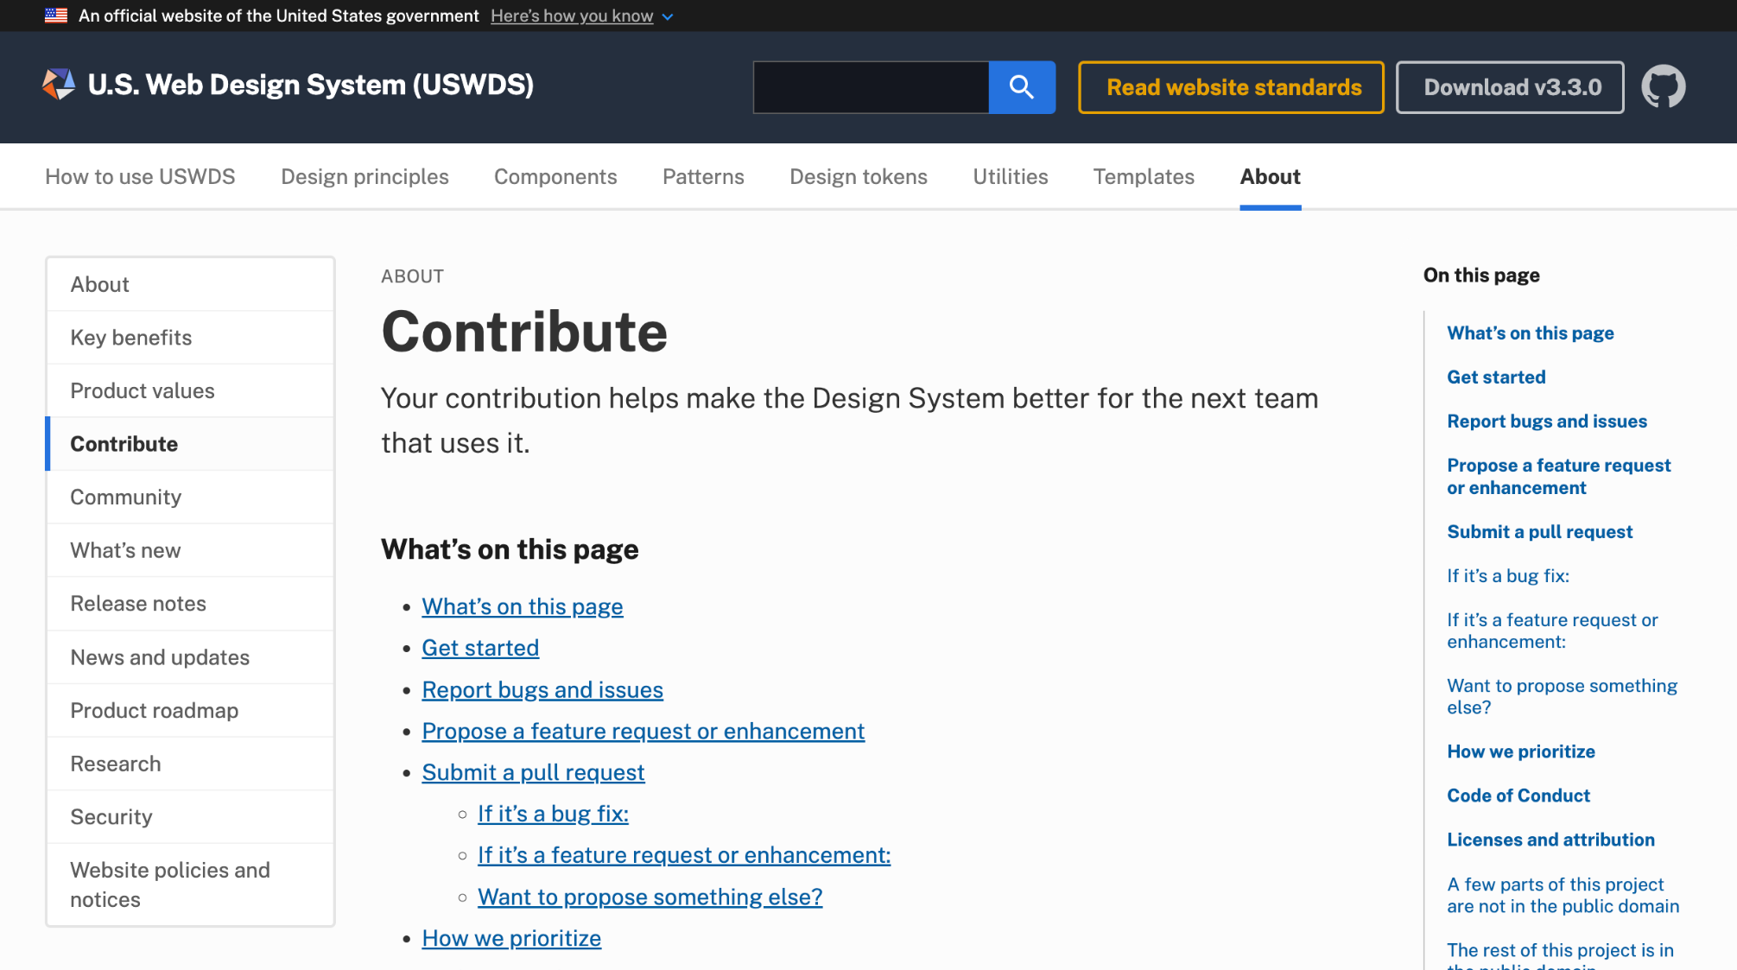
June 2022
Updated contributing guidance

Slide 15
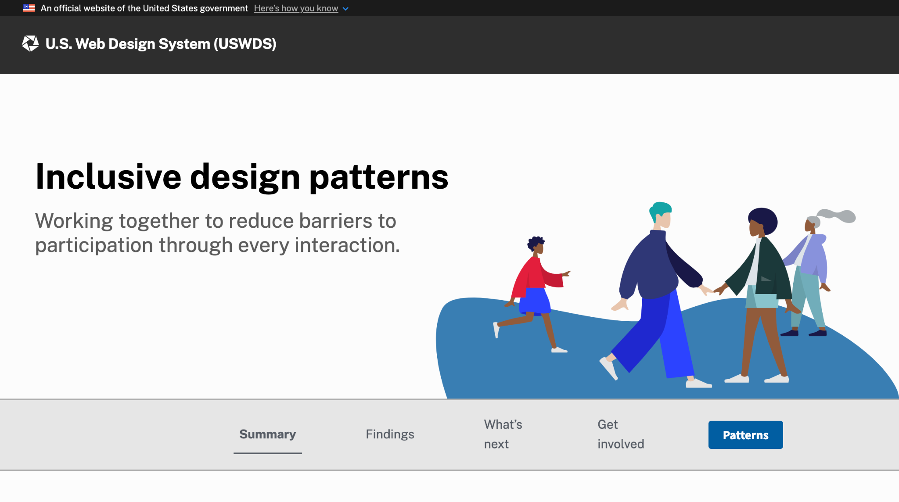
November 2022
Inclusive design patterns

Slide 16
USWDS inclusive design patterns
Inclusive design report
New pattern section with 17 patterns
Three new components

Slide 17

December 2022
USWDS Compile 1.0

Slide 18
But this year wasn’t just about
these big things
Notes:
DW

Slide 19
James Mejia
he/him
Engineer
USWDS Core Team
Contractor

Slide 20
Amy Leadem
she/her
Front End Developer
USWDS Core Team
Contractor

Slide 21
Charlie Mahoney
he/him
Engineer
USWDS Core Team
Contractor

Slide 22
Jacline Contrino
she/her
UX Researcher
USWDS Core Team
Contractor

Slide 23
Transparent workflows
The USWDS Project Board
Notes:
DW

Slide 24
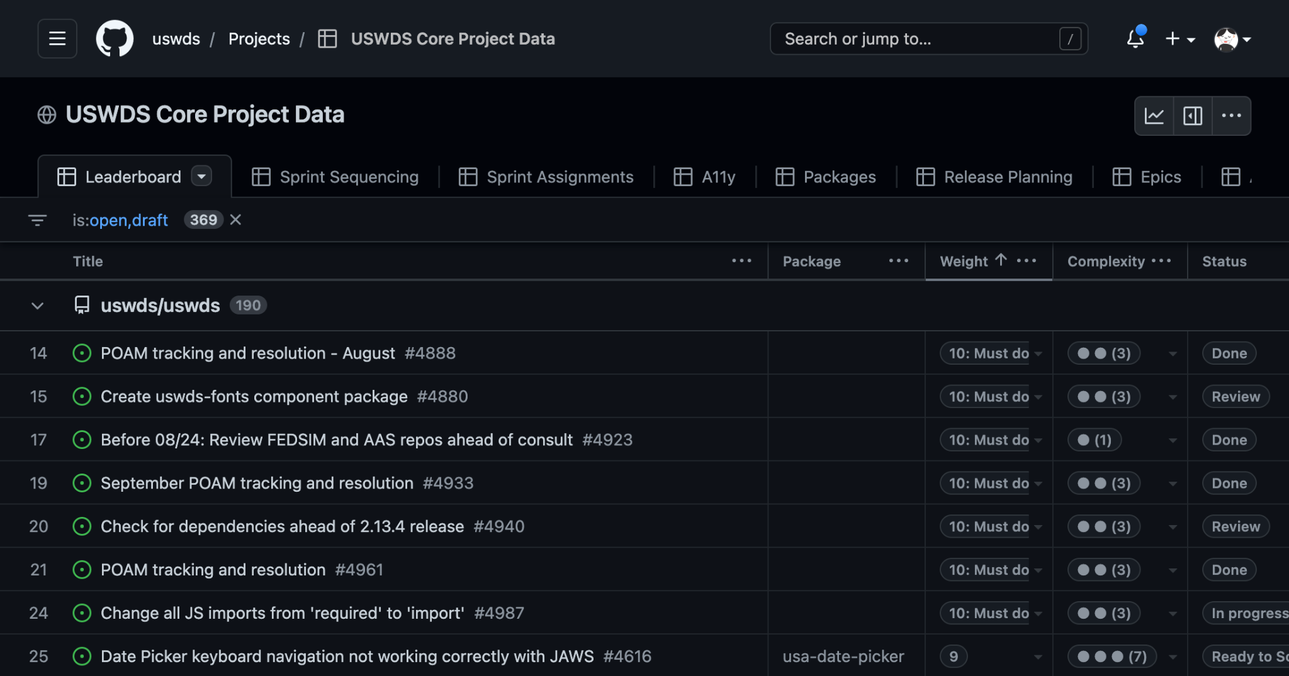
Organization and prioritization
Notes:
DW

Slide 25
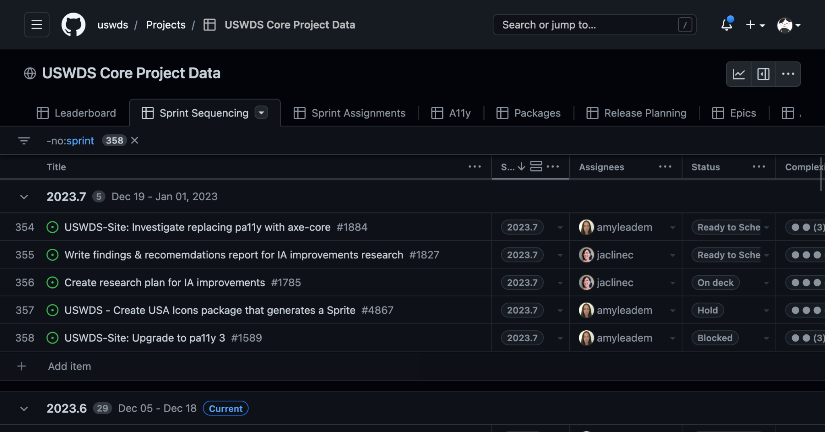
Sprint to sprint
Notes:
DW

Slide 26
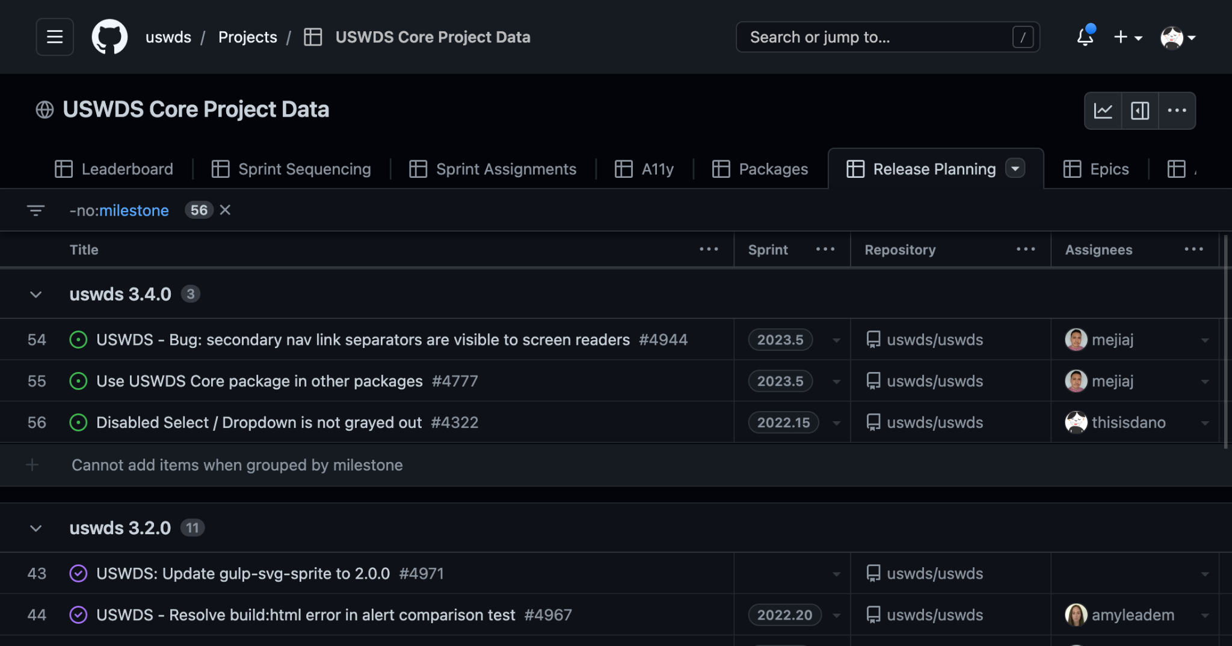
Releases
Notes:
DW

Slide 27
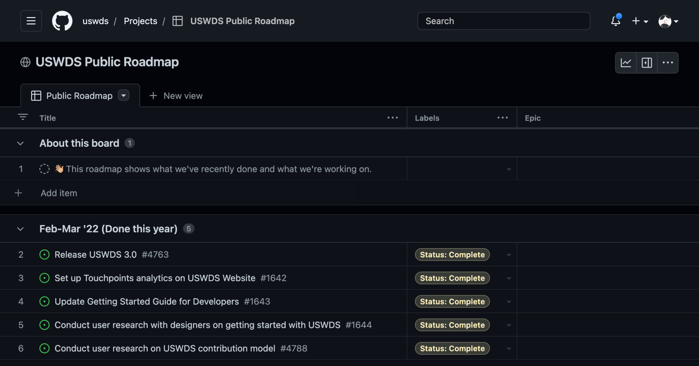
Roadmap
Notes:
DW

Slide 28
Come see what we’re doing.
github.com/uswds/projects/8
Notes:
DW

Slide 29
Telling the story of the code
Improving issues, pull requests, and changelogs
Notes:
DW

Slide 30
This has had a big impact on how our team works
Notes:
DW

Slide 31
Thoughtful, thorough writeups improve transparency
Notes:
DW

Slide 32
Better information and communication improves speed
Notes:
DW

Slide 33
This is a long-term project. Process documentation helps our future selves and those that come after us.
Notes:
DW

Slide 34
Don’t assume familiarity.
Use plain language.
Notes:
DW

Slide 35
Issues:
Something that should be done.
And why.
Notes:
DW

Slide 36
Better issues lead to better work
Notes:
DW

Slide 37
Bug reports
Description
Instructions to reproduce
Expected behavior
Related code
Screenshots
System setup
Additional context
Template structure
Notes:
DW

Slide 38
Make the case
Who is affected? Who benefits?
Is there a workaround?
How much effort is required to work around it?
What is the effect if nothing is done?
Why does this request matter?
Notes:
DW

Slide 39
Pull requests: One problem at a time
Notes:
DW

Slide 40
Each pull request is a record in the history of our codebase
Notes:
DW

Slide 41
Summary
Example:
Updated the aria-label in English versions of usa-banner. We updated the banner component's aria-label to read "Official website of the United States government" to minimize potential screen reader ambiguity between "An official" and "Unofficial". Fixes #4419
A 1-2 sentence overview of the changes you’re proposing
Notes:
DW

Slide 42
Problem statement
Example:
When read out on a screen reader, the statement "An official website of the United States government" can sound like "UNofficial website of the United States government". This introduces the risk of conveying a meaning opposite of the intended meaning.
Convey the desired state, the actual state, and the effects of remaining in the current state
Notes:
DW

Slide 43
Solution statement
Example:
Updating the aria-label gives us the ability to reduce confusion for those using screen readers without creating inconsistency in the visual presentation.
Outline the changes that the PR is proposing
Notes:
DW

Slide 44
Testing
Example:
This component was tested on VoiceOver on Safari, Chrome, Firefox, and Edge for Mac.
Please test on your available screen readers to confirm that the component is introduced as "Official website of the United States Government".
Describe how to check your work
Notes:
DW

Slide 45
Reviewing:
Be kind, thoughtful, and don’t be afraid to make suggestions
Notes:
DW

Slide 46
Changelogs
Notes:
DW

Slide 47
Make a helpful history. For humans.
Notes:
DW

Slide 48
Get the full story without leaving our website
Notes:
DW

Slide 49
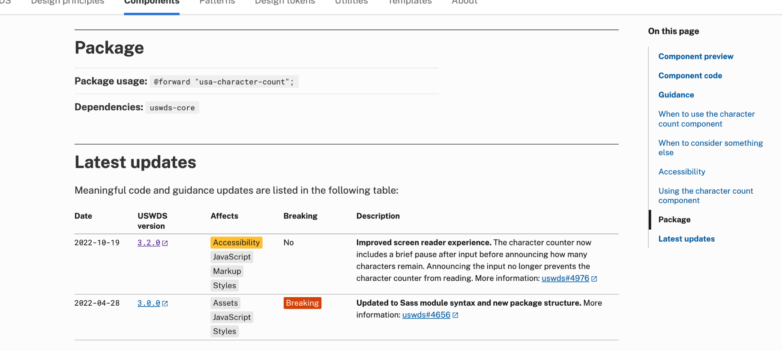
Easy to find. Easy to scan. Easy to get more information.
Notes:
DW

Slide 50
A web of documentation
Notes:
DW

Slide 51
Adapting to user settings
Support for Windows High Contrast Mode
Notes:
DW

Slide 52
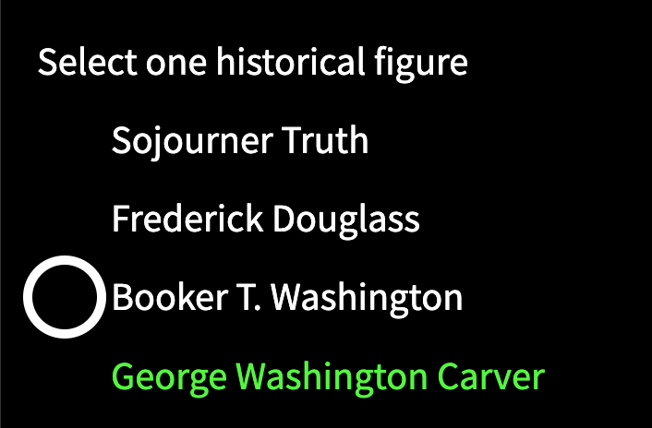
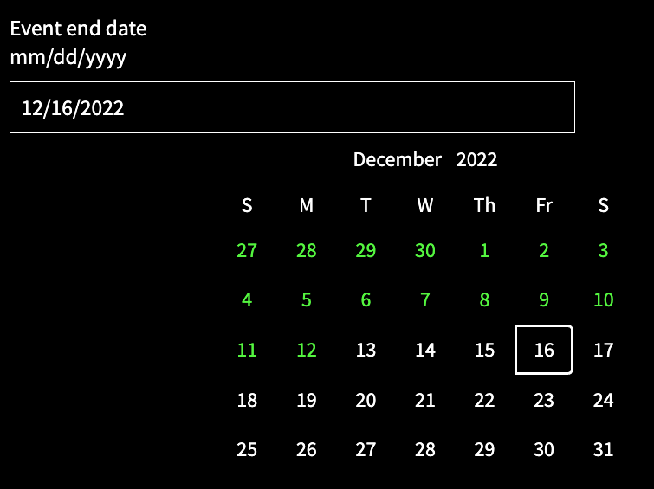
We discovered some major problems!
Disappearing radio buttons
Vanishing Date Picker UI
Notes:
DW

Slide 53
Windows High Contrast Mode
Notes:
DW

Slide 54
Why use High Contrast Mode?
Better see elements on the screen
Improve focus
Ease eye strain and migraines
Aesthetic preference
Notes:
DW

Slide 55
Low-vision users don’t always use screen readers
Notes:
DW

Slide 56
The forced-colors media query!
Notes:
DW

Slide 57
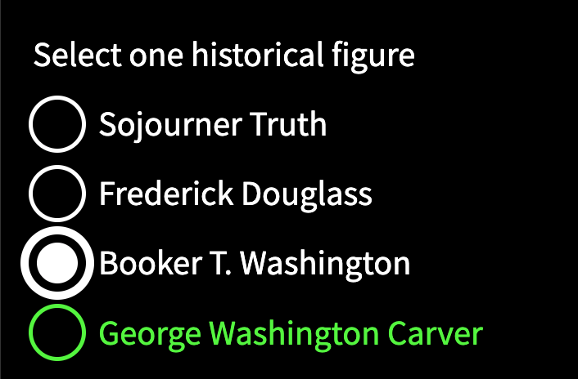
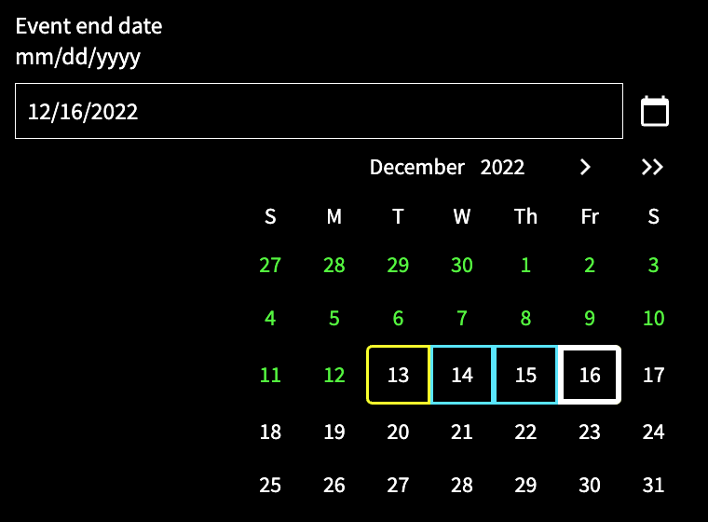
We fixed these and 11 other components
Radio buttons returned!
Date Picker UI now appears!
Notes:
DW

Slide 58
Requirements by default
Autoprefixing with USWDS Compile
Notes:
DW

Slide 59
USWDS Compile makes it easier to compile and upgrade
Notes:
DW

Slide 60
When you compile USWDS Stylesheets, you need Autoprefixer
Autoprefixer settings:
>2%
last 2 versions
IE 11
not dead
This assures that any supported browser gets proper code formatting
Notes:
DW

Slide 61
Autoprefixer settings make a difference
Autoprefixer off
Autoprefixer on
Notes:
DW

Slide 62
Use USWDS Compile and get rid of those icon rectangles!
Notes:
DW

Slide 63
Simple icon sprites
Custom icon sprites using USWDS Compile
Notes:
DW

Slide 64

We include 245 icons in our default sprite. It’s 71 KB.
Notes:
DW

Slide 65

But maybe you don’t need all of them.
Notes:
DW

Slide 66
Demo
Notes:
DW

Slide 67
Learning what’s important
Top Tasks
Notes:
DW

Slide 68
How do we prioritize the information on our website?
Notes:
DW

Slide 69
Top Tasks: The most important tasks on your website
Notes:
DW

Slide 70
Stuff like this…
Design kits
Writing & content guidance
Customize with tokens
Settings and theme configuration
Customize utilities
JavaScript customization
Component guidance
Component compliance to section 508
Browse components
Examples of sites that use the design system
FAQs & tutorials
Customer service
General UX and accessibility guidance
Github repos
Install design system package
Assess maturity
How to incrementally adopt design system
Monthly call
Migration
Design pattern guidance
Prototyping
View supporting research
Design system compatibility
Browse templates
Learn about design tokens
Token reference
New features
Code and guidance changes
and more…
Notes:
DW

Slide 71
This will help us make better decisions
Notes:
DW

Slide 72
So, keep your eyes peeled for a survey!
Notes:
DW

Slide 73
Put a bow on it
Notes:
DW

Slide 74
Q&A
Notes:
DW

Slide 75
Next month
January: USWDS FAQ
#uswds-public
github.com/uswds
designsystem.digital.gov

